Slide 1
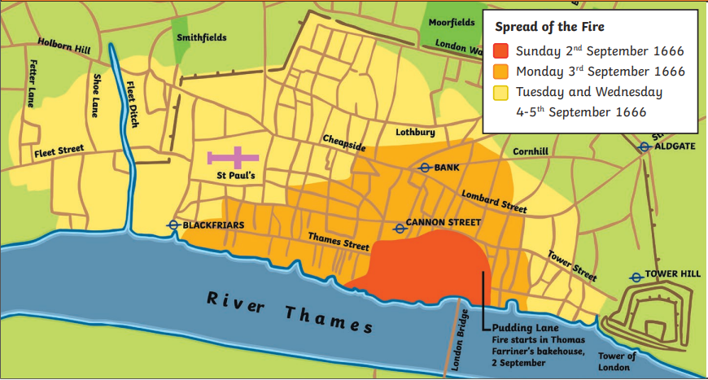
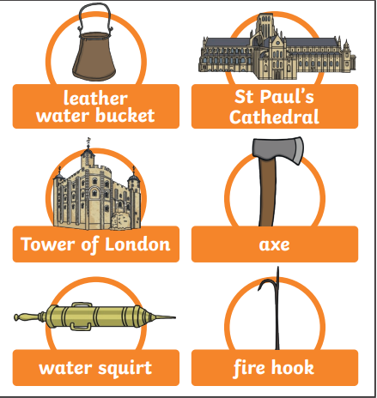
Eversley Primary School– Knowledge Organiser
History | The Great Fire of London | Year 2 | Autumn
Key Knowledge
2nd Sept 1666 | Fire broke out in a bakery on Pudding Lane
3rd Sept 1666 | People start to leave the city, many by boats on the Thames
4th Sept 1666 | St Paul’s Cathedral is destroyed by the fire.
5th Sept 1666 | The wind dies down and the fire stops spreading.
6th Sept 1666 | The fire is finally put out and thousands of people are left homeless.
Background Information
The Great Fire of London started in the early hours of the morning of 2nd September 1666, in a baker’s shop on pudding Lane. By 5th September the fire had destroyed more than 13,000 houses and buildings in the city, including 87 churches and St Paul’s Cathedral. The fire spread quickly, destroying most of the buildings in its path. The way houses were built, the lack of an effective and organised firefighting service and the weather in the days before, all played their part in the terrible event.
Key Vocabulary
Spelling | Definition
Bakery | A place here bread or cakes are made and sold
London | The capital city of England and the United Kingdom.
River Thames | The river running through London
Diary | A personal record of life’s events
Eyewitness | A person who was at an event ad describes it to others.
Flammable | Easily set on fire
Important People
Thomas Ferriner | The baker who owned the bakery on Pudding Lane
Samuel Pepys | An eyewitness who wrote a recount of the fire in his famous diary
King Charles II | King of England in 1666 He made a decree after the fire, stating that all houses must be built further apart and from stone, not timber
Diagrams and Symbols

