Slide 1
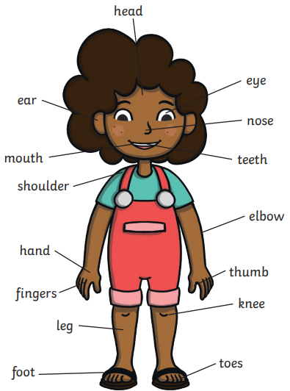
Science | Animals, Including Humans | Year 1 | Autumn Term
Key Vocabulary
Amphibians | Amphibians live in the water as babies and on land as they grow older. They have smooth, slimy skin.
Birds | All birds have a beak, two legs, feathers and wings.
Fish | Fish live and breathe under water. They have scaly skin, fins to help them swim and they breathe through gills.
Mammals | Mammals are animals that breathe air, grow hair or fur and feed on their mother’s milk as a baby.
Reptiles | All reptiles breathe air. They have scales on their skin.
Carnivore | Animals that mostly eat other animals (meat) are carnivores.
Herbivore | Animals that only eat plants are herbivores.
Omnivore | Animals that eat both plants and other animals are omnivores.
Statutory Requirements
To be able to identify and name Identify and name a variety of common animals including fish, amphibians, reptiles, birds and mammals. To be able to describe and compare the structure of a variety of common animals (fish, amphibians, reptiles, birds and mammals, including pets). To be able to identify and name a variety of common animals that are carnivores, herbivores and omnivores. To be able to identify, name, draw and label the basic parts of the human body and say which part of the body is associated with each sense.
Key Knowledge
Sight | Your eyes let you see all the things around you.
Hearing | Your ears let you listen to all the things around you. Your brain is able to tell what different sounds are.
Touch | Your skin gives you the sense of touch. You can tell if something is warm, cold, smooth or rough without even looking at it.
Taste | Your sense of taste comes from your tongue. You can tell if something tastes bitter or sweet. You might have some tastes you like and some you don’t.
Smell | You smell using your nose. Your nose can tell if things smell nice or not nice.
Possible Experiences
Use observations in the local environment to compare animals or through videos and photographs. Describe how to identify and group animals. Group animals according to what they eat. Label the different parts of the body and describe what each part does. Participate in a sensory experience where you taste, fell, look at and see different foods (check for allergies first). Use senses to compare different textures, sounds and smells.

